Slide 2
Deproach concept in general
In need of flight simulator
  MS flight simulator?
FAF-VP leg
  Simplified case
OLS
  Angle, shape
POI
  Train station, etc …
Further consideration
  MAP procedure -> noise, bdg
  Population data
  Air right?

Slide 3
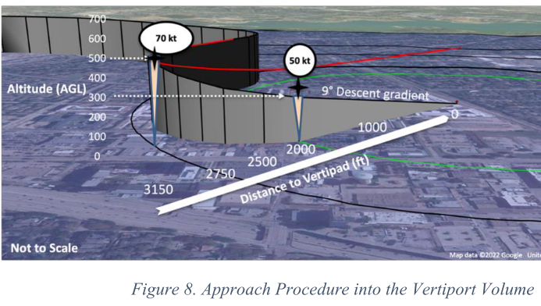
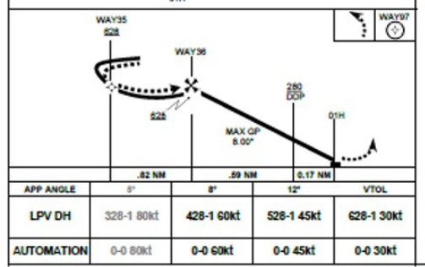





Deproach concept
Outer ring
Transition ring
Inner ring
FATO
leg 3
FAF
leg 2
IF
$$R_{2}$$
$$α_{2}$$
IAF
$$R_{1}$$
$$α_{1}$$
leg 1
y_{FAF}
y_{IAF}
y_{FATO}
$$θ$$
x_{FAF}
x_{IF}
x_{IAF}

Slide 4
비행고도, descent/ascent angle에 따른 deproach dimension 변화(+ 이에 따른 소음 영향권 변화)
Deproach 컨셉에 따르면, 기체는 Outer Ring의 Initial Approach Fix (IAF)→ Intermediate Ring의 Intermediate Fix (IF) → Inner Ring의 Final Approach Fix (FAF)로 진행
IAF에서 FAF까지 같은 고도를 유지한 채 Radius-to-Fix (RF) leg을 따라 선회 후, FAF에서 Vertiport (VP)까지 Track-to-Fix (TF) leg을 따라 하강
VPㅡFAF 간 거리는 desired altitude 와 descent angle에 따라 상이
  NASA 연구에서는 desired altitude를 500~600 ft above vertiport elevation으로, descent angle의 경우 5°, 8°, 12°로 설정
  (예) (desired altitude, descent angle) = (500 ft, 8°) 일 때, d(VP,FAF) = 3,557 ft (0.59 NM) , 12° 일 때 2,352ft (0.39 NM)
Notes:
위 그림처럼 descent angle에 따라 deproach dimension / 소음 영향권이 변화하는데, 연구에서 몇몇 조합에 대해 평가하는 방향으로 진행하면 좋을 듯 합니다 (concept vehicle 특성과, NASA 연구 중 descent angle과 비행속도에 따른 퍼포먼스 - passenger comfort, safety, efficiency, pilot rating - 를 Joby flight simulator로 평가한 결과를 참고해서 조합을 결정하면 어떨까 싶습니다)

Slide 5

2. Ring 크기, 기체속도, 선회구간 중심점 위치에 따라 Radius-to-fix (RF leg) 형태 변화
Deproach 개념에 따르면 기체는 outer ring에서 특정 속도(예: 100 kts)를 유지한 채 IAF에 도달, FAF까지 감속하며(60 kts or below) RF leg 비행
VP─IAF 거리에 따라 RF leg 형태는 아래 그림과 같이 변화
  IAF에서의 속도(V_{IAF})는 100 kts, bank angle(ϕ)은 25° 미만으로 고려하였으며, bank angle은 turn radius(R) 및 ground speed(V_{ground})를 가정하여 산정 (
)
Notes:
concept vehicle 특성을 바탕으로 waypoint에서의 속도, descent angle, deceleration rate 등을 고려해서 RF leg을 설계하고, RF leg에서의 bank angle 이 적정한지 살펴보는 실험이 필요할 것 같습니다.
관련하여 NASA 연구에서는 simulator 기반 실험에서 아래 가정 및 parameter 조합을 검토한 바 있습니다
Bank angle $φ$ $≤30$°
Enroute phase : max. speed 100 kts (KIAS)
Departure phase : glide path angle (5°, 8°, 12°) & max. speed (40, 60, 80 kts)
Approach phase : 5° & 90 kts , 8° & 75 kts, 12° & 45 kts

Slide 6
Main Corridor와 연결성을 고려한 waypoint에서의 속도, deproach dimension 등 결정
여의도 공원을 기준으로 살펴보았을 때, 한강 회랑과의 연결성을 고려한다면 우측 그림처럼 descent angle을 높이는 대신 규정 속도를 낮춰 절차를 구성할 필요가 있어 보입니다. 도심지 context에 따라 design parameter를 조정해서 소음 영향을 살펴봐야 할 것 같습니다.

Slide 7
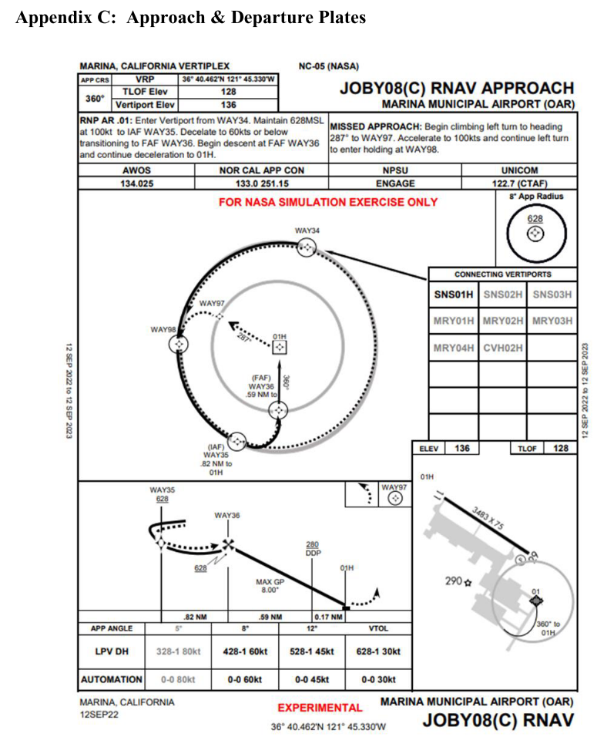
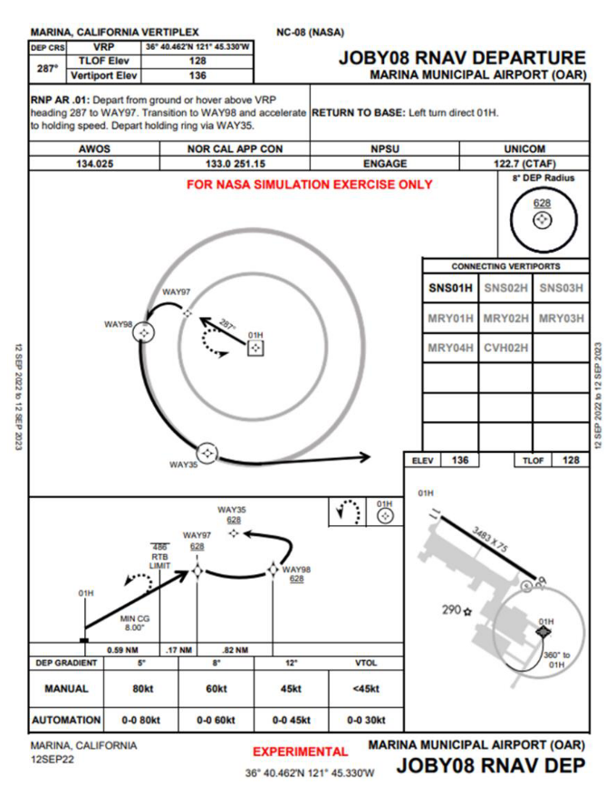

Slide 8
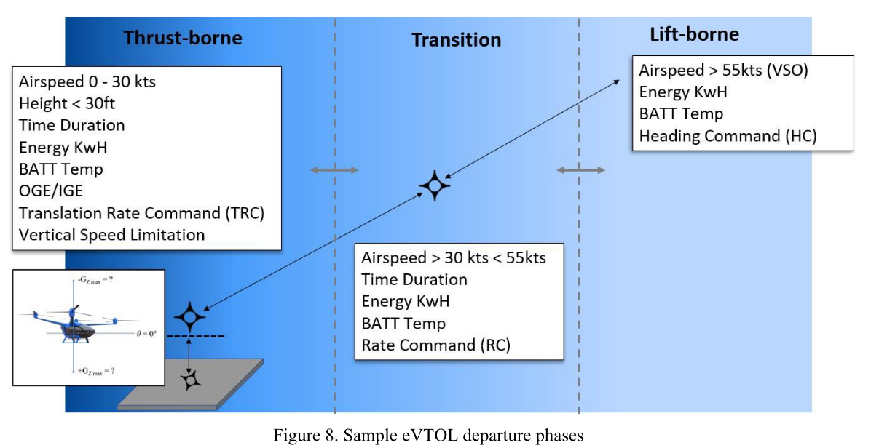
Overall Procedure

Slide 9
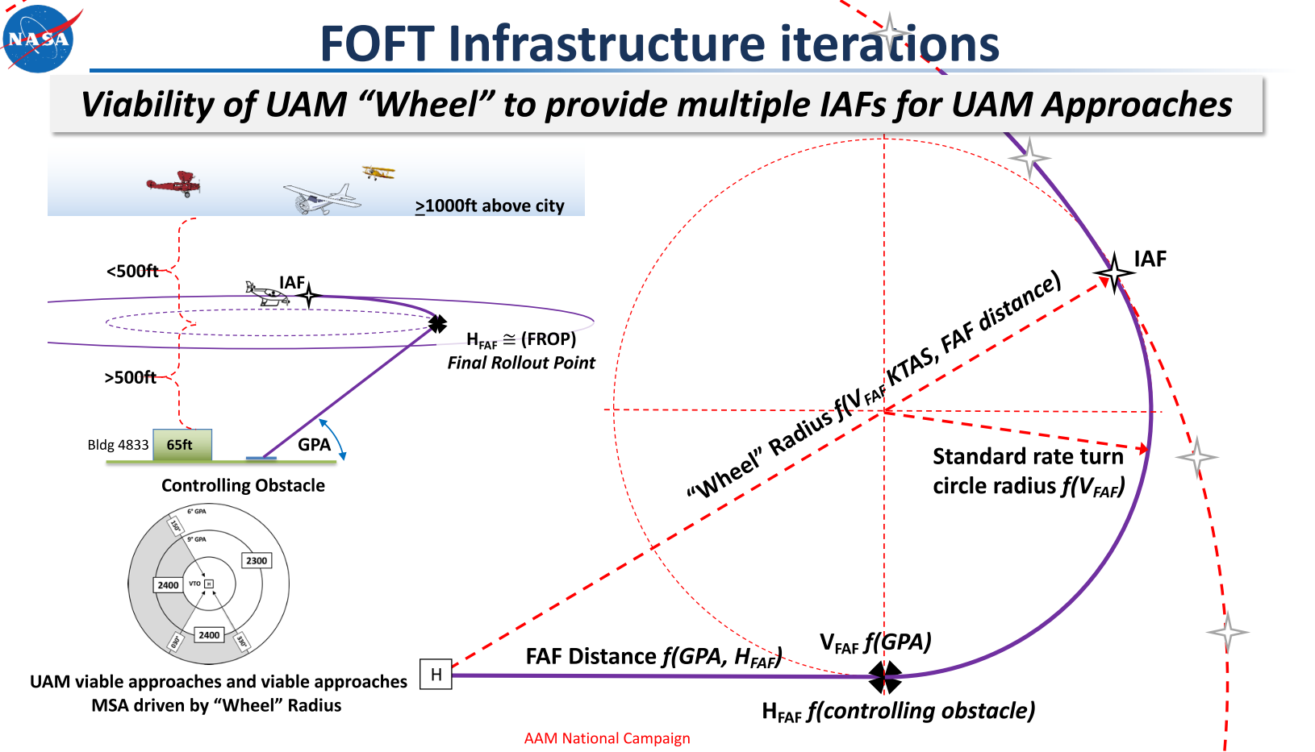
UAM ‘Wheel’ concept
Notes:
3° per second turn, a 360° turn in 2 minutes

Slide 10
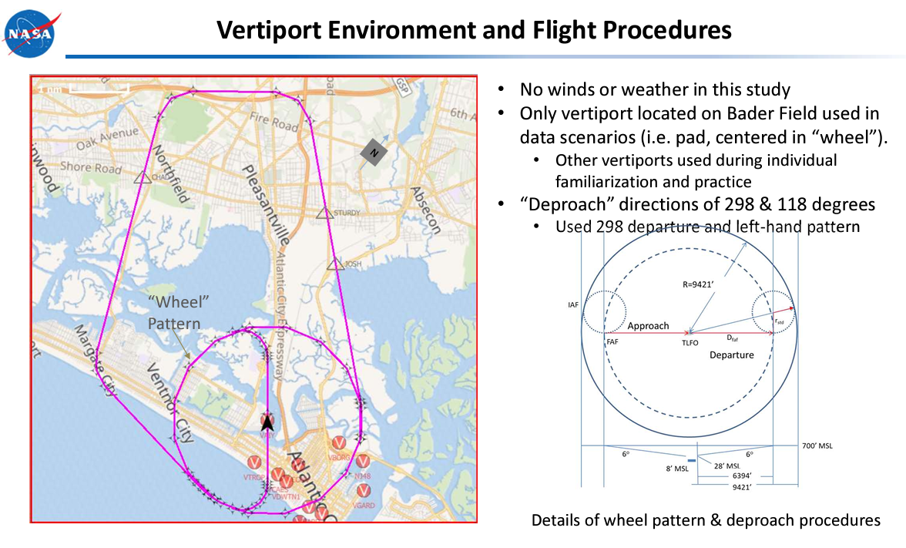
UAM ‘Wheel’ concept

Slide 11
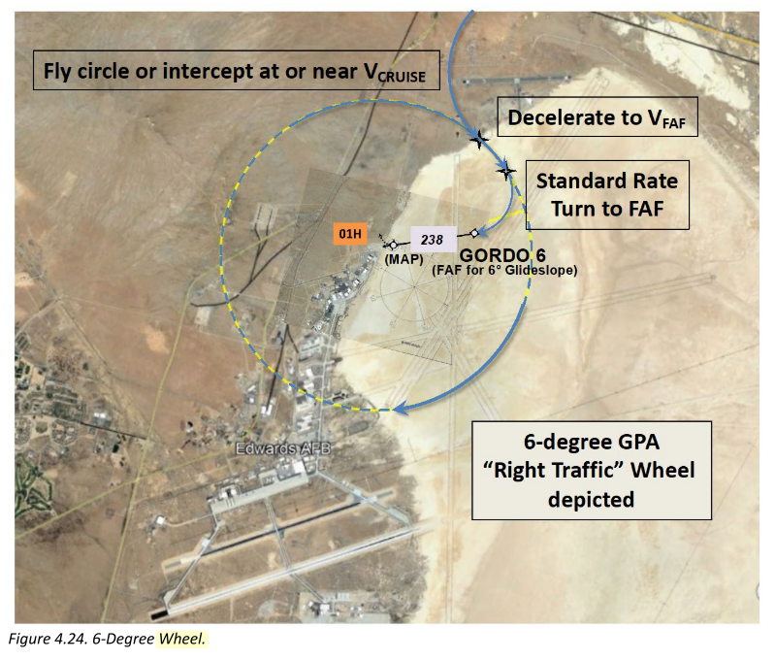
UAM ‘Wheel’ concept

Slide 12
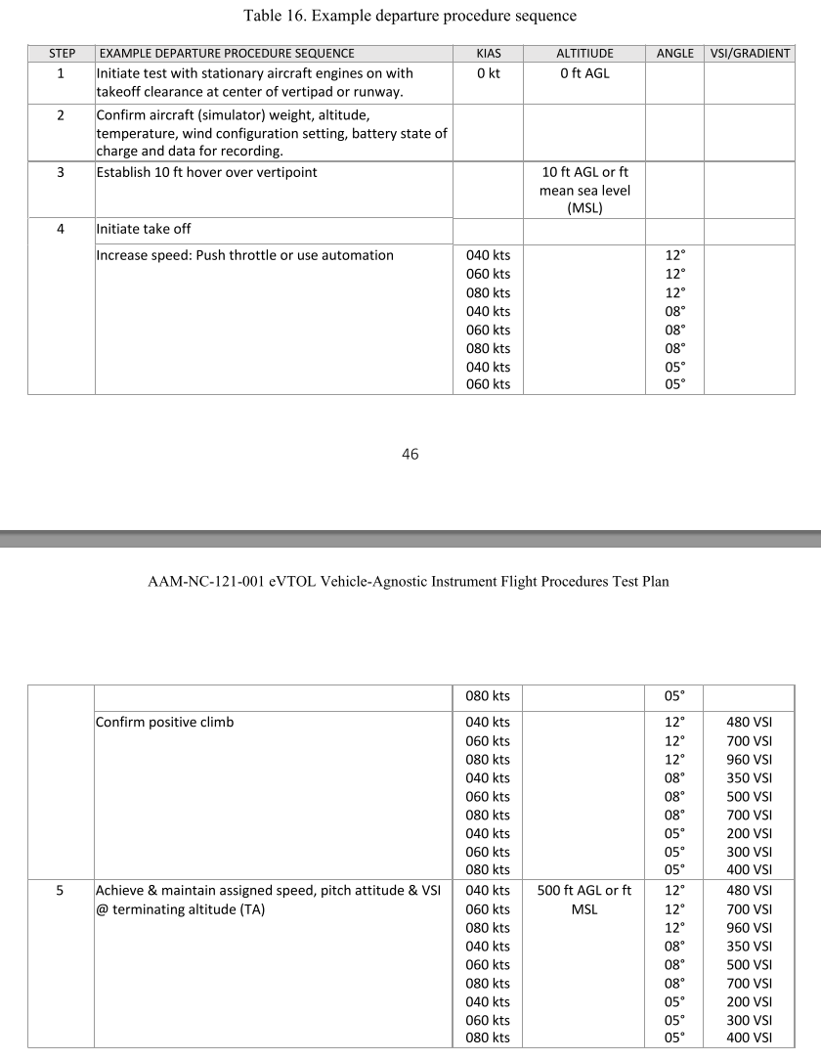
Departure procedure sequence

Slide 13
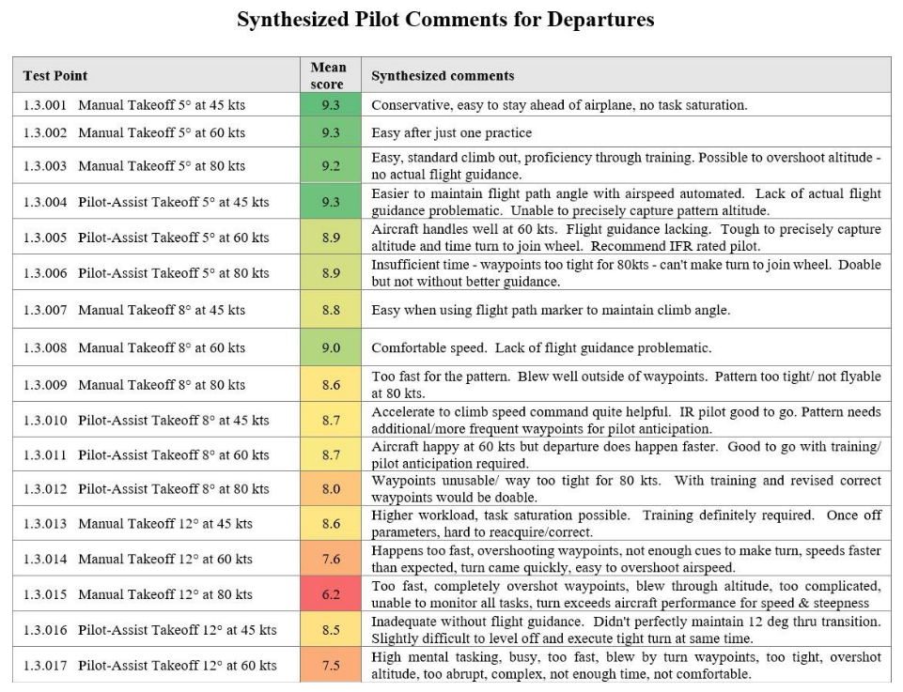
Departure
Pilot rating w.r.t. speed, angle

Slide 14
Departure safety, comfort, rating w.r.t. speed, angle
Flight Phase | Parameter |  | Safety |  | Passenger Comfort |  | Pilot Rating
 | Glidepath angle | max. speed (kts) | Vertical deviation | Lateral deviation | Linear acceleration jerk rate | Rotational Acceleration | Rating |  | Pilot Comments
Departure | 5 | 45 | Least deviation | Least deviation | Most comfortable | Most comfortable | Highest rating | 9.3 | Conservative, easy to stay ahead of airplane, no task saturation.
 |  | 60 | Moderate | Moderate | Comfortable | Within Limits | Acceptable | 9.3 | Easy after just one practice
 |  | 80 | Most | Most | Comfortable | Within Limits | Acceptable | 9.2 | Easy, standard climb out, proficiency through training. Possible to overshoot altitude - no actual flight guidance.
 | 8 | 45 | Least | Least | Most comfortable | Most comfortable | Acceptable | 8.8 | Easy when using flight path marker to maintain climb angle.
 |  | 60 | Moderate | Moderate | Comfortable | Within Limits | Highest rating | 9 | Comfortable speed. Lack of flight guidance problematic.
 |  | 80 | Most | Most | Comfortable | Within Limits | Acceptable | 8.6 | Too fast for the pattern. Blew well outside of waypoints. Pattern too tight/not flyable at 80 kts.
 | 12 | 45 | Least | Most | Most comfortable | Most comfortable | Highest rating | 8.6 | Higher workload, task saturation possible. Training definitely required. Once off parameters, hard to reacquire/correct.
 |  | 60 | Moderate | Moderate | Comfortable | Within Limits | Workload /Situational awareness | 7.6 | Happens too fast, overshooting waypoints, not enough cues to make turn, speeds faster than expected, turn came quickly, easy to overshoot airspeed.
 |  | 80 | Most | Least | Comfortable | Within Limits | Workload/ Situational awareness | 6.2 | Too fast, completely overshot waypoints, blew through altitude, too complicated, unable to monitor all tasks, turn exceeds aircraft performance for speed & steepness combination.

Slide 15
Departure safety, comfort, rating w.r.t. speed, angle
Flight Phase | Parameter |  |  | Safety |  | Passenger Comfort |  | Pilot Rating
 | Glidepath angle | max. speed (kts) |  | Vertical deviation | Lateral deviation | Linear acceleration jerk rate | Rotational Acceleration | Rating |  | Pilot Comments
Final approach | 5 | 80 | FAF decel | Moderate | Moderate | Comfortable | Within Limits | Workload/Situational awareness
 |  |  | Delayed decel | Least deviation | Least deviation | Most comfortable | Most comfortable | Highest rating
 | 8 | 60 | FAF decel | Least deviation | Least deviation | Most comfortable | Most comfortable | Highest rating
 |  |  | Delayed decel | Moderate | Moderate | Comfortable | Within Limits | Highest rating
 | 12 | 45 | FAF decel | Least deviation | Least deviation | Comfortable | Most comfortable | Workload/Situational awareness
 |  |  | Delayed decel | Moderate | Moderate | Most comfortable | Most comfortable | Highest rating
FAF decel: decelerating the aircraft immediately upon reaching the Final Approach Fix (FAF); decelerate at a constant rate
Delayed decel: aircraft delays the start of deceleration until after passing the FAF; a smooth, gradual deceleration closer to the runway to maintain a better flight path

Slide 16
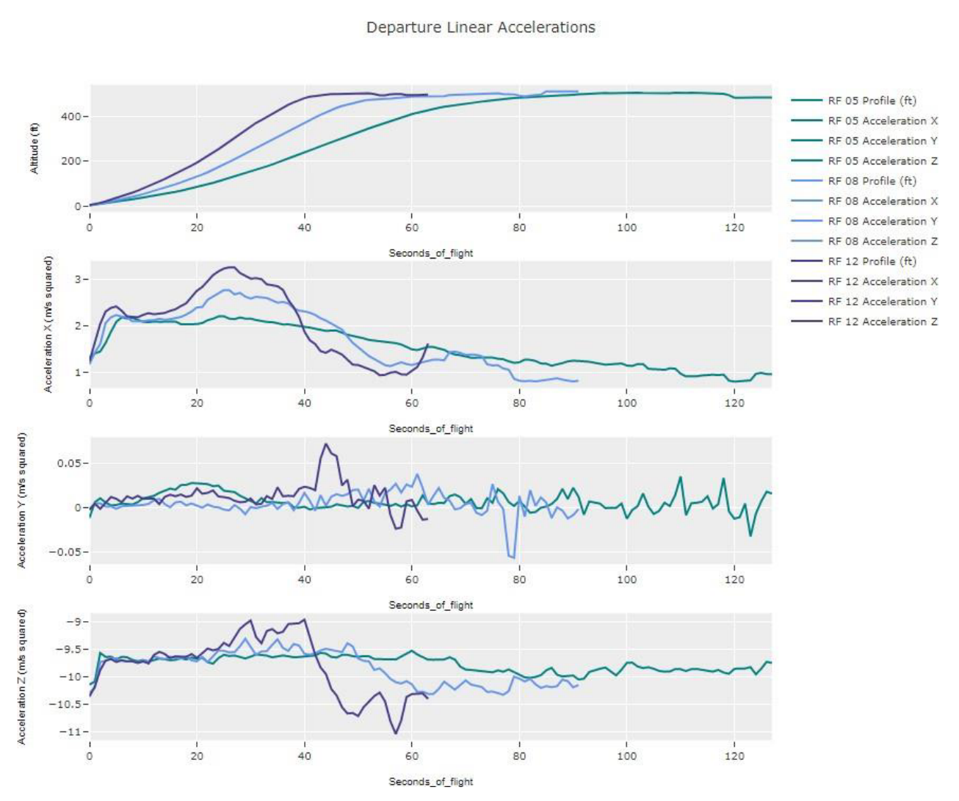
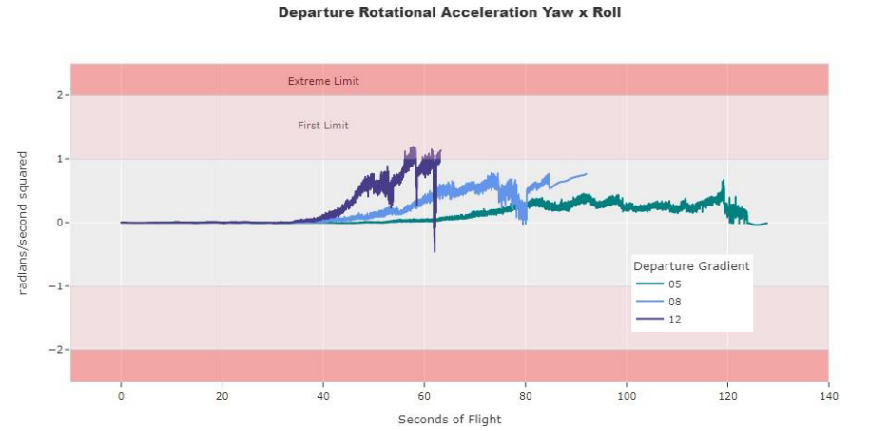
Departure
Linear and Rotational Acceleration w.r.t angle

Slide 17
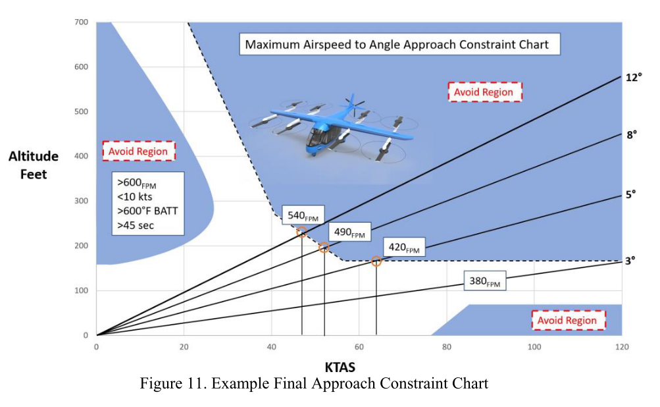
Speed, angle vs. flight stability

Slide 18
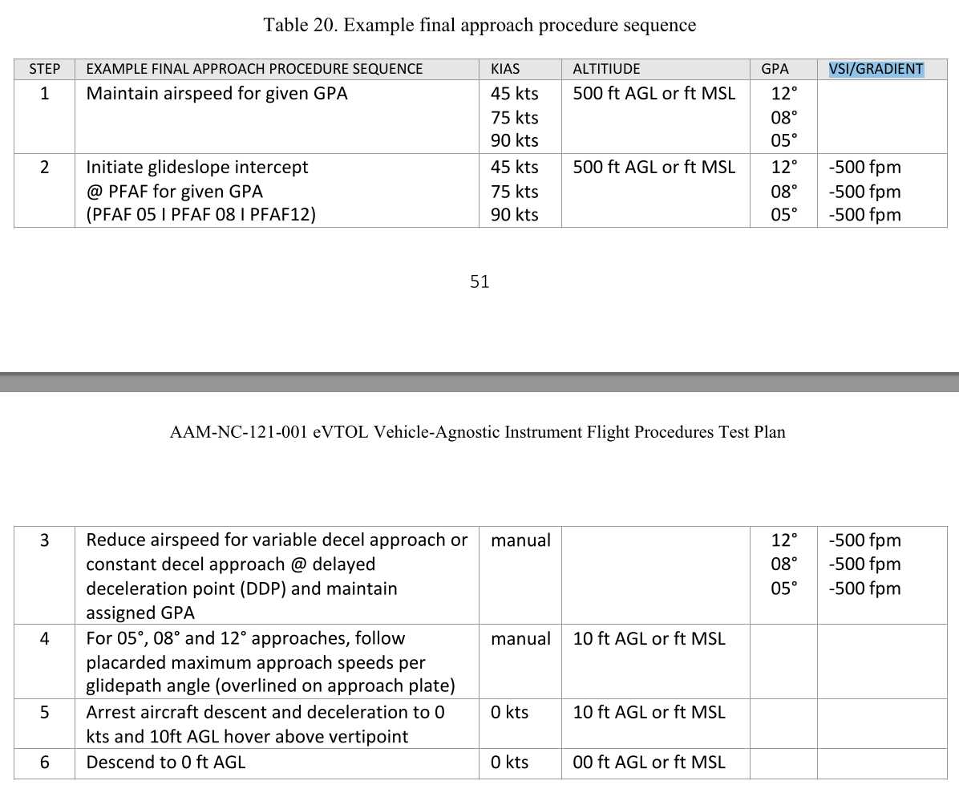
Approach procedure sequence

Slide 19
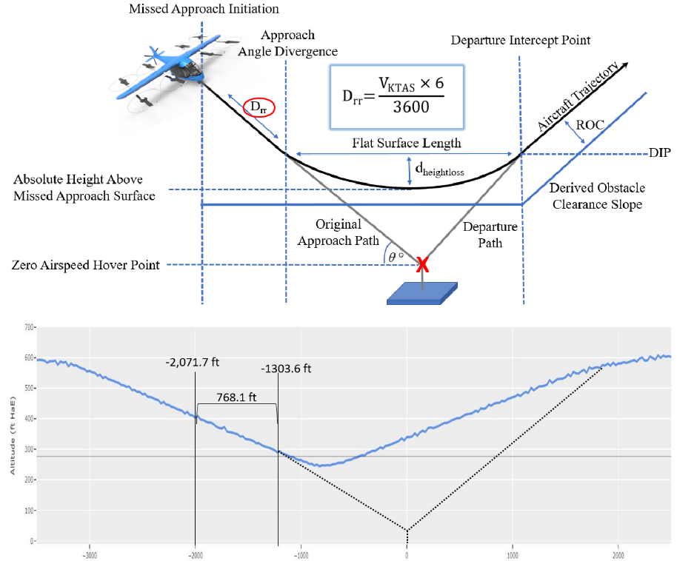
Missed Approach Procedure
Notes:
Distance of Reaction and Roll (DRR)
refers to the distance an aircraft requires to react and roll (typically during landing or takeoff) after a control input or disturbance, such as during a go-around or missed approach
This distance accounts for the aircraft's ability to respond to changes in control inputs (such as when the pilot or automated system commands a roll or adjustment to the flight path). It includes the aircraft's reaction time and the additional distance required for the aircraft to stabilize after making the change
Flat Surface Length (FSL)
is the minimum horizontal distance required for the aircraft to transition from a descent to a stable, level flight or glidepath.
In the context of landing procedures, the FSL defines the length of the horizontal path that must remain flat or level, allowing the aircraft to stabilize before final descent and landing. It is important for ensuring a smooth transition from approach to landing without abrupt changes in the flight path.
Distance of Height Loss (2σ)
refers to the distance the aircraft will descend (height loss) based on the standard deviation of altitude loss during the approach phase. "2σ" suggests a range within which the height loss is expected to occur, typically covering 95% of the expected altitude deviation.
In a flight procedure, height loss represents the vertical distance the aircraft might lose during an approach, accounting for variations in speed, descent rate, and environmental conditions.
The "2σ" notation likely refers to the statistical confidence interval (95%), meaning that the aircraft will typically lose this amount of height with 95% certainty during the approach.
Approach Angle Divergence
refers to the variation or spread in the angle of descent or approach that an aircraft can safely follow while still maintaining a proper glidepath to the runway or landing point.
It defines the range of acceptable approach angles that the aircraft can take without straying from the designated path or encountering obstacles. This is important in situations where the approach may need to be adjusted due to wind, obstacles, or traffic.

Slide 20
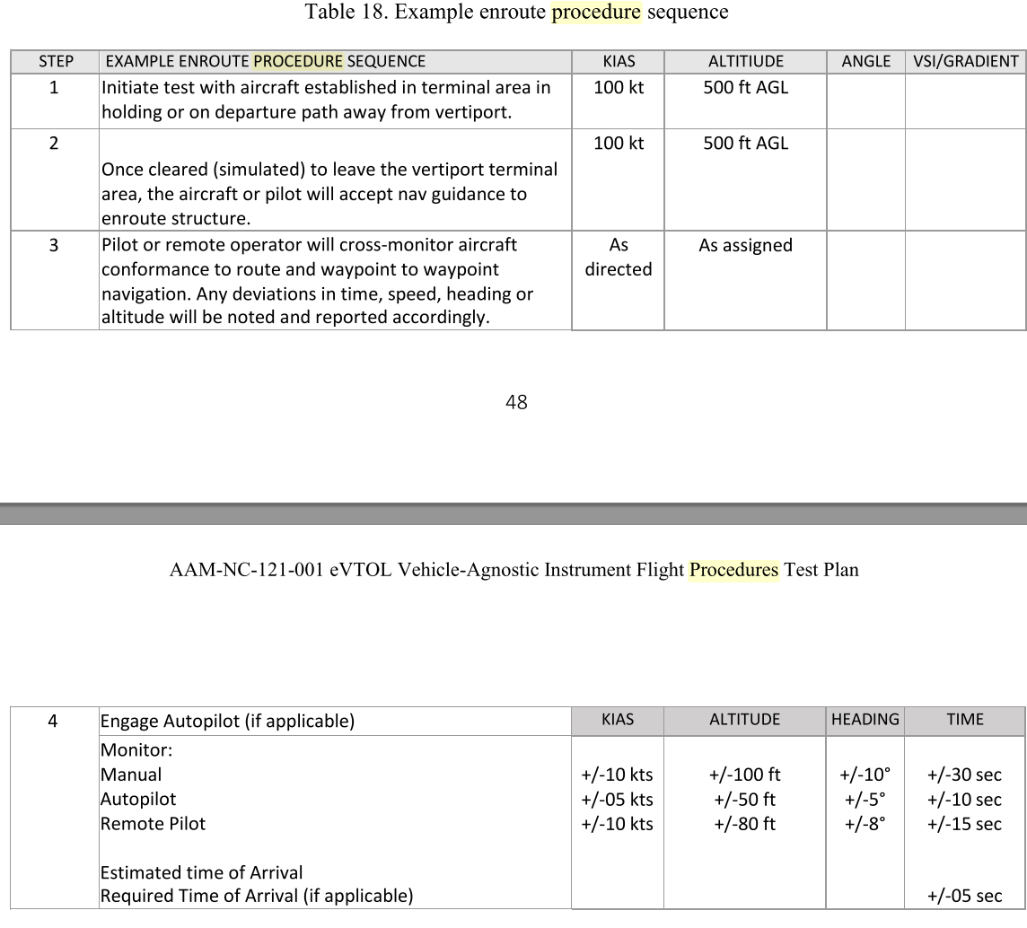
Enroute procedure sequence

Slide 21
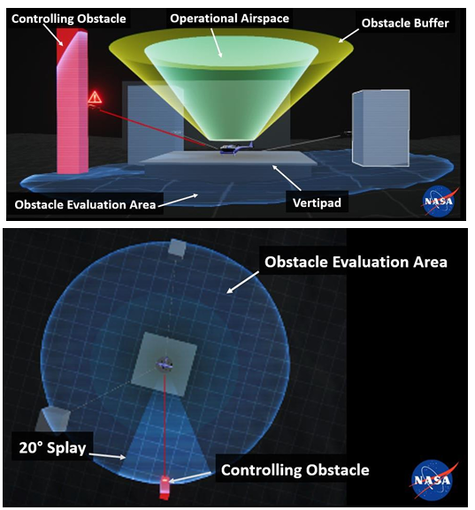
OLS

Slide 22
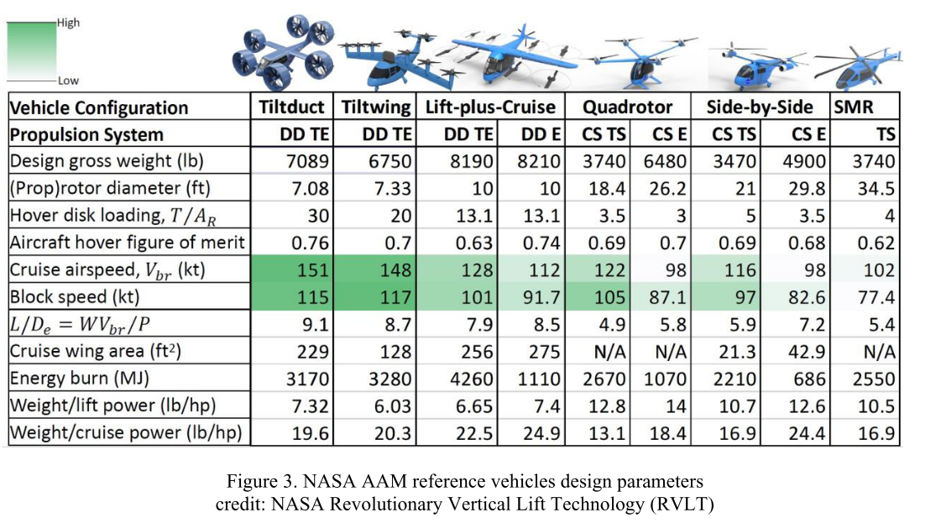

Slide 23
H_IAF = h_FAF?
RF transition?
d(VP,FAF) <- h_FAF, descent/climb angle
  descent angle : 8, 12 deg
  Climb angle : 8, 12 deg
H_FAF <- geospatial context, corridor altitude
  1,100 ft MSL (NASA X4 simulation)
  H_FAF = 500 ft above VP
Max speed, turn radius -> bank angle

Slide 24



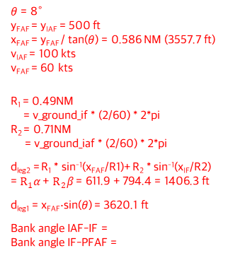


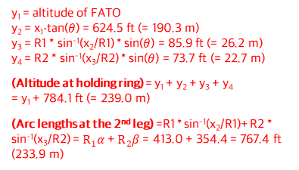



Outer ring
Holding
ring
Transition ring
Inner ring
Final
approach
ring
$θ$ = 8°
y_{FAF} = y_{IAF} = 500 ft
x_{FAF} = y_{FAF} / tan($θ$) = 0.586 NM (3557.7 ft)
v_{IAF} = 100 kts
v_{FAF} = 60 kts
R₁ = 0.49NM
= v_ground_if * (2/60) * 2*pi
R₂ = 0.71NM
= v_ground_iaf * (2/60) * 2*pi
d_{leg2} = R₁ * sin⁻¹(x_{FAF}/R1)+ R₂ * sin⁻¹(x_{IF}/R2) =$R_{1}α$ + $R_{2}β$ = 611.9 + 794.4 = 1406.3 ft
d_{leg1} = x_{FAF}·sin($θ$) = 3620.1 ft
Bank angle IAF-IF =
Bank angle IF-PFAF =
FATO
1구간
PFAF
FATO
leg 3
FAF
IF
leg 2
IF
R₁
2구간
$$R_{2}$$
$$α$$
$$α_{2}$$
IAF
IAF
R₂
$$R_{1}$$
$$β$$
3구간
$$α_{1}$$
leg 1
x₁ = dist(VP, PFAF) = 2938.0 ft (= 895.5 m)
x₂ = 0.13x₁ = 381.9 ft (= 116.4m)
x₃ = 0.12x₁ = 352.6 ft (= 107.5m)
(Holding ring radius) = x1+x2+x3 = 3672.5 ft
y_{FAF}
y_{IAF}
y₁ = altitude of FATO
y₂ = x₁·tan($θ$) = 624.5 ft (= 190.3 m)
y₃ = R1 * sin⁻¹(x₂/R1) * sin($θ$) = 85.9 ft (= 26.2 m)
y₄ = R2 * sin⁻¹(x₃/R2) * sin($θ$) = 73.7 ft (= 22.7 m)
(Altitude at holding ring) = y₁ + y₂ + y₃ + y₄
= y₁ + 784.1 ft (= 239.0 m)
(Arc lengths at the 2nd leg) =R1 * sin⁻¹(x₂/R1)+ R2 * sin⁻¹(x₃/R2) =$R_{1}α$ + $R_{2}β$ = 413.0 + 354.4 = 767.4 ft (233.9 m)
y₄
$$θ$$
y₃
y_{FATO}
x_{FAF}
x_{IF}
x_{IAF}
y₂
$$θ$$
y₁
x₁
x₂
x₃

Slide 25



Holding
ring
Final
approach
ring
FATO
1구간
PFAF
IAF
R₁
2구간
$$α$$
IAF
R₂
$$β$$
3구간
R₁ = 0.1NM (607.6 ft)
R₂ = 1.0NM (6076.1 ft)
y₄
y₃
x₁ = dist(VP, PFAF) = 2938.0 ft (= 895.5 m)
x₂ = 0.13x₁ = 381.9 ft (= 116.4m)
x₃ = 0.12x₁ = 352.6 ft (= 107.5m)
(Holding ring radius) = x1+x2+x3 = 3672.5 ft
y₂
$$θ$$
y₁ = altitude of FATO
y₂ = x₁·tan($θ$) = 624.5 ft (= 190.3 m)
y₃ = R1 * sin⁻¹(x₂/R1) * sin($θ$) = 85.9 ft (= 26.2 m)
y₄ = R2 * sin⁻¹(x₃/R2) * sin($θ$) = 73.7 ft (= 22.7 m)
(Altitude at holding ring) = y₁ + y₂ + y₃ + y₄
= y₁ + 784.1 ft (= 239.0 m)
(Arc lengths at the 2nd leg) =R1 * sin⁻¹(x₂/R1)+ R2 * sin⁻¹(x₃/R2) =$R_{1}α$ + $R_{2}β$ = 413.0 + 354.4 = 767.4 ft (233.9 m)
y₁
x₁
x₂
x₃

Slide 26
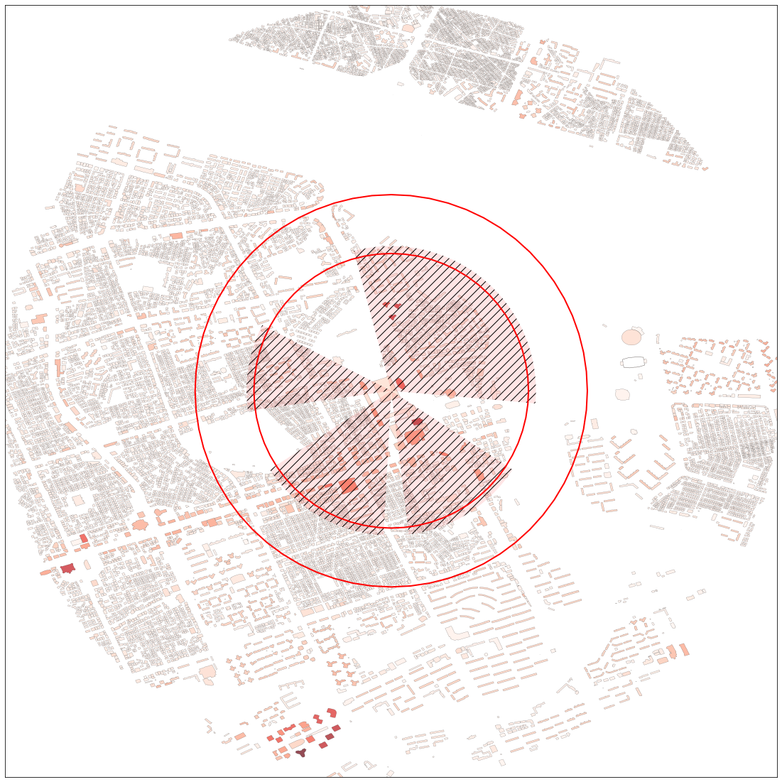
Obstacle Limitation Surface (OLS)
Slope : 8/12.5
Vertiport obstacle-free volume with omnidirectional approach and take-off climb surface and prohibited sector — top view

Slide 27
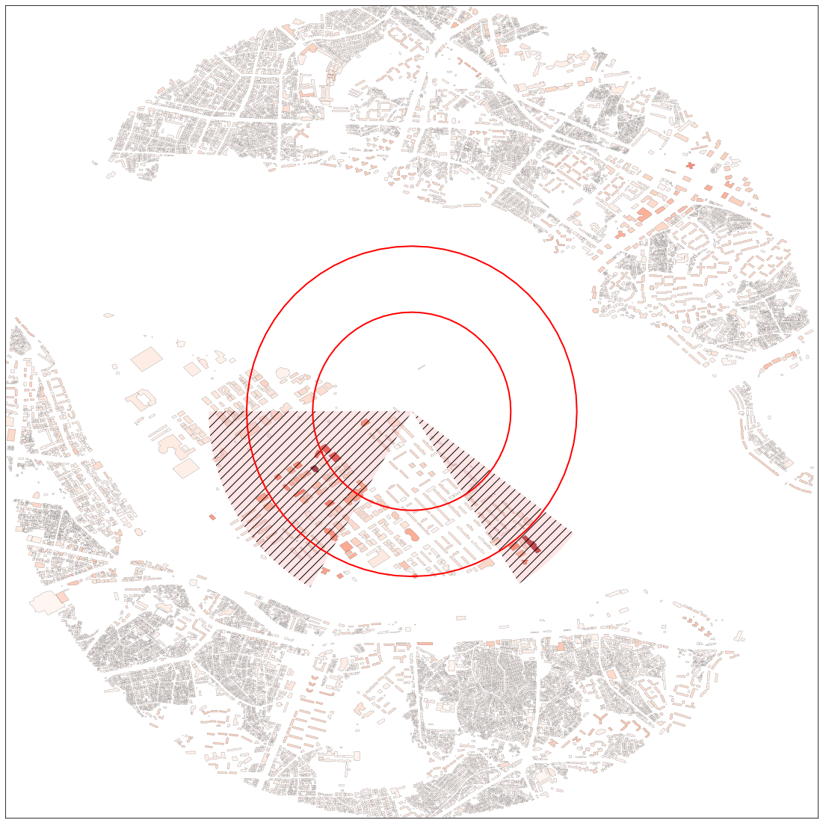
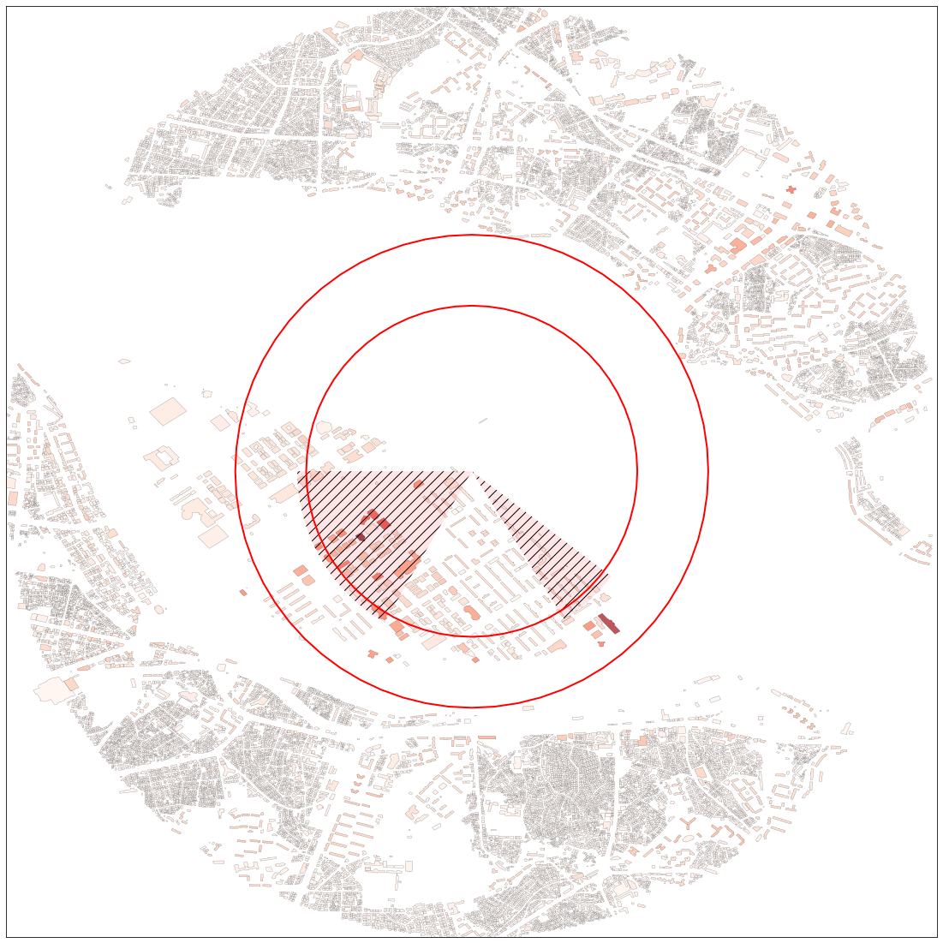

Slide 28
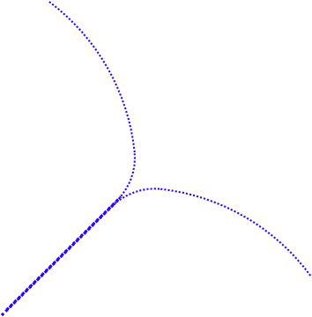
2구간
3구간
1구간
Veriport
Final approach ring
Holding ring

Slide 29
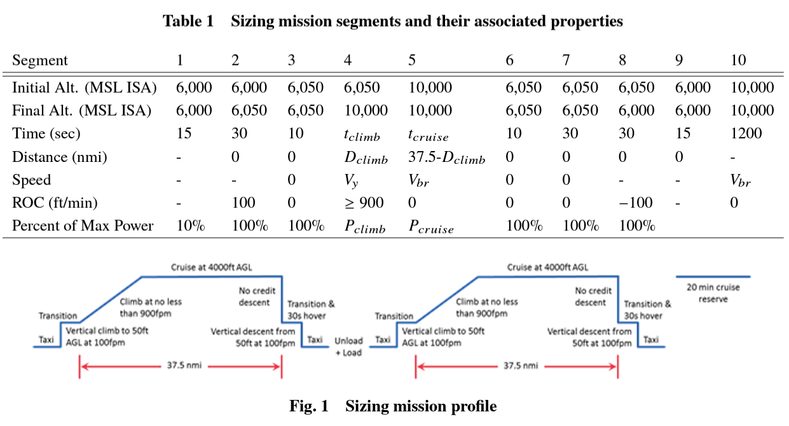

Slide 30
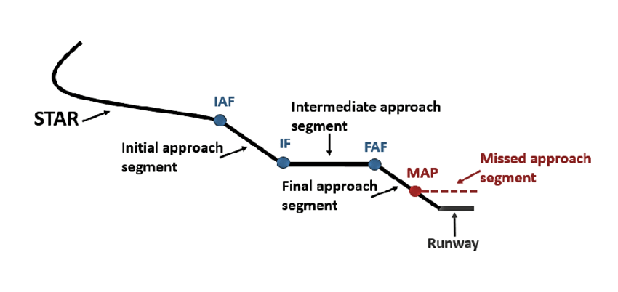
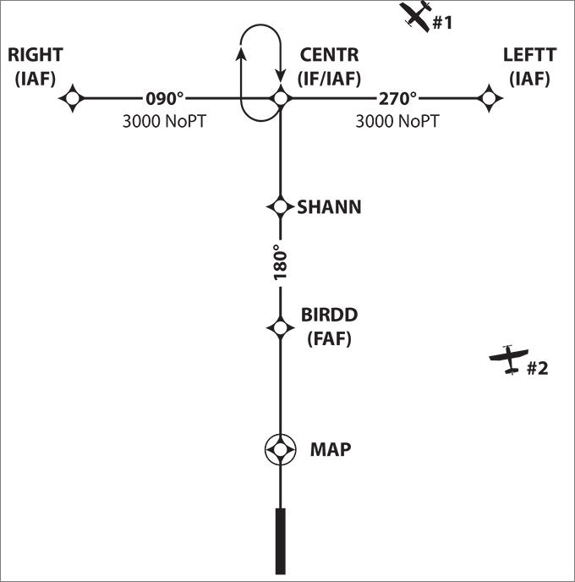
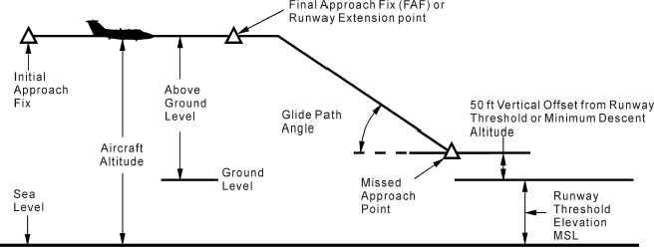
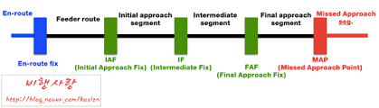

Slide 31
